Slide 1

Strong Authentication with Multi-Factor Authentication
WSO2 Identity Server Fundamentals

Slide 2
Authentication

Slide 3
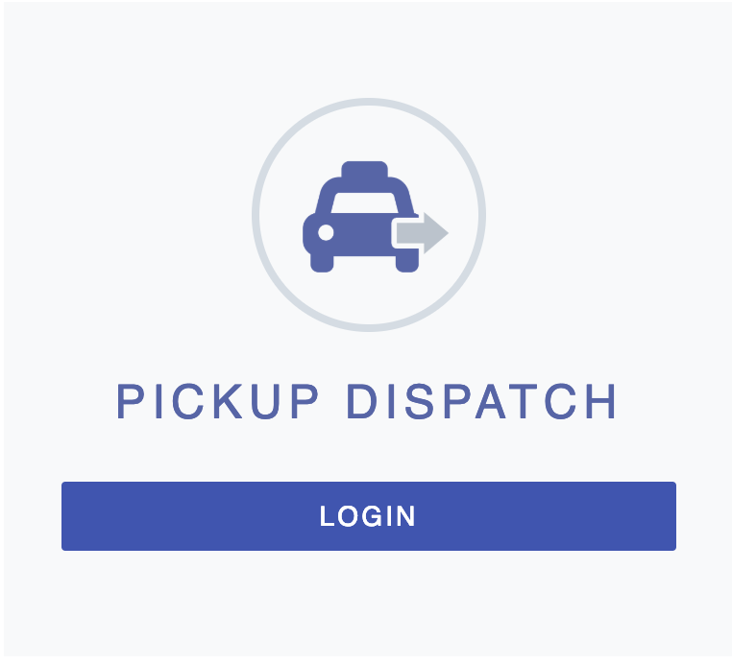
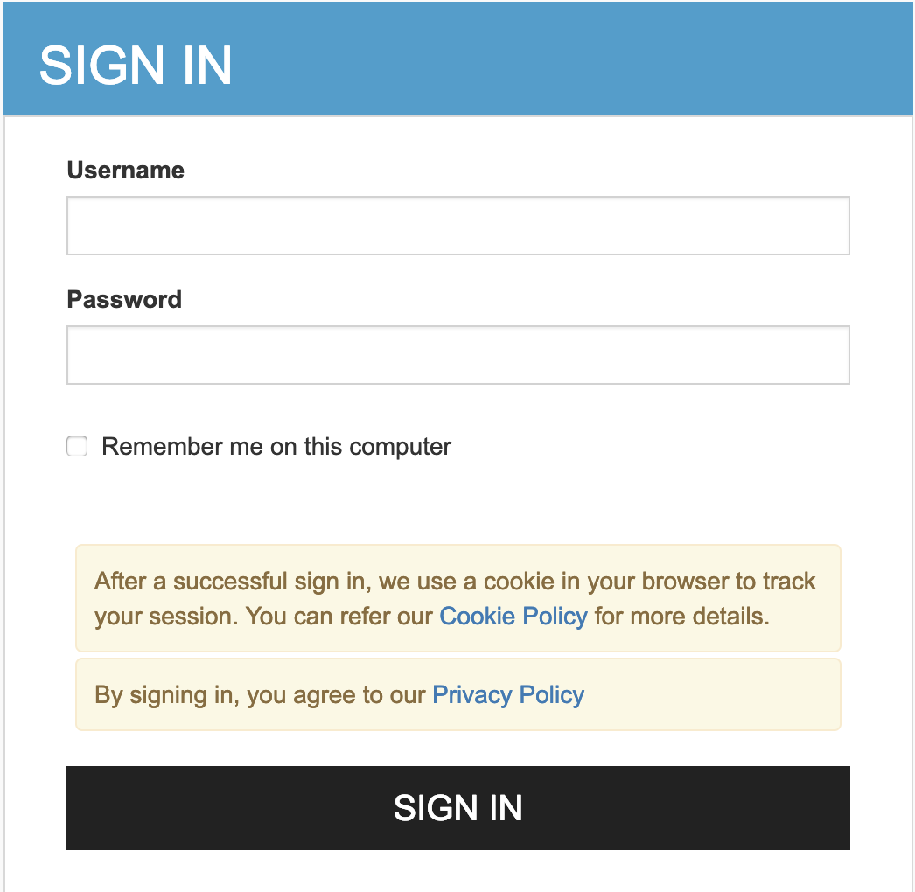
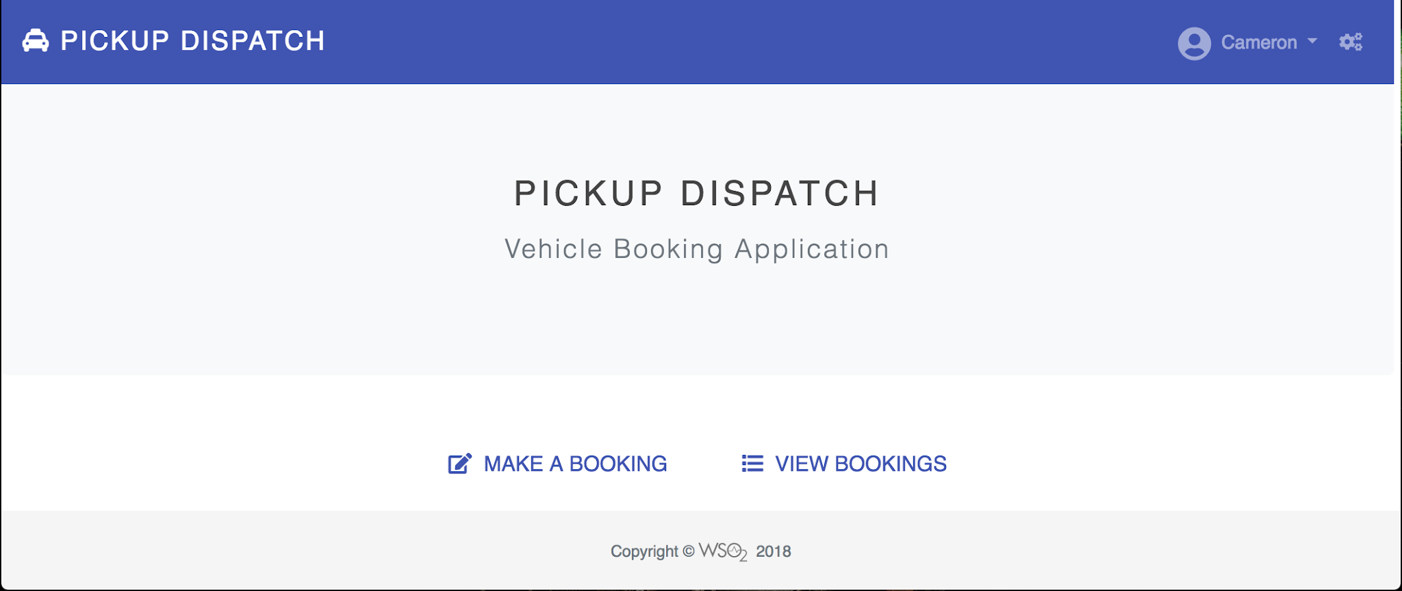
What is Authentication?
Authentication is the process used to distinctly identify a certain entity using:
  Knowledge factor: Something the user knows, e.g., password, PIN, and security question.
  Ownership factor: Something the user has, e.g., ATM card, identity card, mobile phone, and security token.
  Inherence factor: Something the user is/does, i.e., biometrics.

Slide 4






Authentication Mechanisms Based on the Number of Factors
Authenticating users by challenging them with multiple authentication steps
Application
Application User
[John Doe]
Identity Provider (IdP)
WSO2 Identity Server

Slide 5
Multi-Factor Authentication

Slide 6
Benefits of Using Multi-Factor Authentication
Security
Compliance
Usability

Slide 7

Convenience vs. Security
What to prioritize
Convenience
Security

Slide 8
Quick Recap

Slide 9

About authentication
Benefits and usage of multi-factor authentication
What you learnt

Slide 10



Any Questions ?
Reach us through the following channels
iam-dev@wso2.org
https://stackoverflow.com/questions/tagged/wso2-identity-server
https://discord.com/invite/Xa5VubmThw

Slide 11
Thank you!
Notes:
Acknowledge that it’s been a lot of changes within the team
Thank you for your taking onboard the feedback and being open to change.
A lot of work , a lot of learning, sometimes feeling twice the exhaustion
But also hopefully seeing what I see, which is: better ways of working, more innovation in our approach, more business acumen, more effective reactivity , more ahead of the game. Because that’s where marketing needs to be.
All this in a context where it’s also been a lot of changes for WSO2.
And from this standpoint I wanted to remind you of what Sanjiva said about you owning the culture

